Slide 1
Burns and Scalds

Slide 2
Definition
Damage inflicted on any part of an organism as the direct or indirect result of exposure to steam, chemicals, heat, flame and electricity with or without disruption of structural continuity; for burn due to over exposure to the sun use (sunburn).

Slide 3
Burns and Scalds
Causes
Heat
UV Radiation
Electrical current
Hot liquid and steam
Acids
Alkaline when come in contact with skin

Slide 4
Burns and Scalds
Burns classified in to 3 degree according to the depth

Slide 5
Burns and Scalds
First degree burns
Only the epidermis is involved
the basal layer of the epidermis is not destroyed and the wound is healed with in 3-6 days without scaring
This type of burn occurs in sun burning also in hot liquid and steam

Slide 6
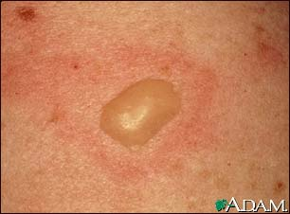

Slide 7
Burns and Scalds
Second degree burns
The epidermis and part of dermis are destroyed
Both first and second degree burn contain blisters

Slide 8
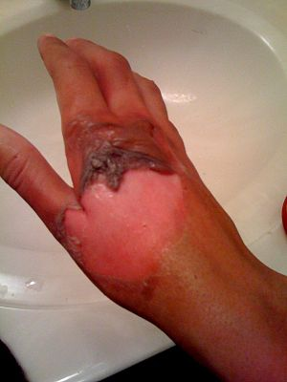

Slide 9
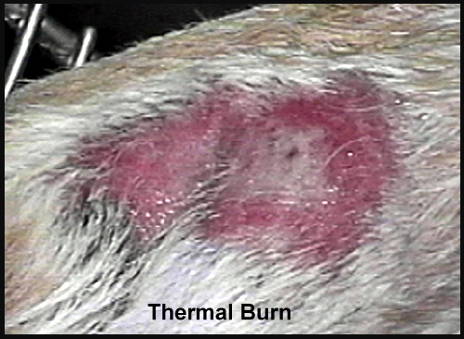

Slide 10
Burns and Scalds
Third degree
The entire thickness of the skin and all the skin structures are destroyed
In general the third degree burns has insensitive surface not like the first and second degree of burns

Slide 11
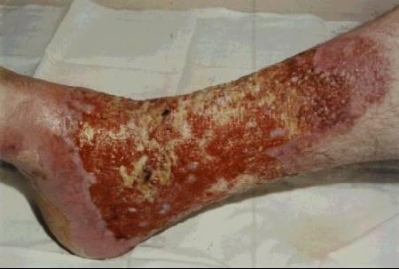

Slide 12
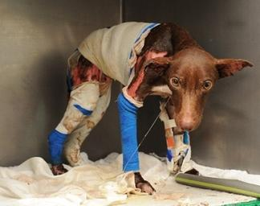

Slide 13
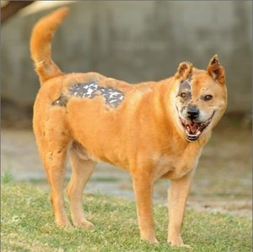

Slide 14
FIRST AID
Two pairs of Latex, or other sterile gloves
Sterile dressings to stop bleeding
Cleansing agent/soap and antibiotic towelettes to disinfect
Burn ointment to prevent infection
Adhesive bandages in a variety of sizes
Antiseptic solution
Scissors, tweezers, tape

Slide 15
Burns and Scalds
Treatment
Hair on the burn surface and surrounding skin should be removed and cleaning.
Puncture or rupture of the blister (vesicles) if present.

Slide 16
Burns and Scalds
The area surround the site of burn is gently washed with water and mild soap or detergent antiseptic such as povidone iodine

Slide 17
Burns and Scalds
All debris and all necrotic material should be removed
The area of burn it self is irrigated with warm burn ointment.

Slide 18
Burns and Scalds
The surface of the burn is cover with suitable antiseptic or antibiotic cream and the lesion is bandaged if it needed

Slide 19
Chemical Burns

Slide 20
Chemical Burns
Causes
1- Oxidizing agent
Chromic material, sodium hypochloride
These two type used in metal cleaning, they produce protein coagulation with ulceration after skin contact

Slide 21
Chemical Burns
2- Reducing agent
They are more effective than oxidizing agent
They cause protein denaturization
Like HCL and nitric acid

Slide 22
Chemical Burns
3- Corrosive
These sub. Produce sever denaturization of the T. protein producing soft scar with a shallow indents ulcer
Like phenol, potassium, sodium, and ammonium hydroxide

Slide 23
Chemical Burns
4- Protoplasmic poising
They produce their effect by inhabiting of calcium and other inorganic ions which is necessary for T. viability and function

Slide 24
Chemical Burns
Like tannic acid, formic acid and acetic acid

Slide 25
Chemical Burns
5- Descants
These agent produce their effect by causing dehydration damage or by creating excessive heat
Like sulfuric acid

Slide 26
Chemical Burns
Treatment of chemical injuries
By using specific antidote
Like soda-lime in case of HCL burns, weak acid for alkaline agents

Slide 27
Chemical Burns
In general the most important early treatment for all chemical burns include dilution of chemical agent
by wound irrigation with large amount of water and saline and Debridement of necrotic T.

Slide 28
Chemical Burns
Following the irrigation the wound is treated like a thermal burn by using local medication

